Slide 1
Chapter 8: Aptitude Tests

Slide 2
What Aptitude Tests Do (1 of 3)
Assess cognitive skills and knowledge and psychomotor performance.
Measure one’s ability to perform in future.
Notes:
Assess cognitive skills and knowledge and psychomotor performance:
Aptitude tests can assess cognitive skills and knowledge like in the SAT or ACT exams.
They can assess psychomotor performance, such as on the Differential Aptitude Test (or DAT).
Measure one’s ability to perform in future: Aptitude tests measure one’s ability to perform in a job or in college by either directly by having them do stuff (like weld a joint) or trying to “see” relevant abilities by asking questions that require the ability to respond correctly.

Slide 3
What Aptitude Tests Do (2 of 3)
SAT: a brand and not an acronym.
Predictive Validity!
Notes:
8.1. Describe how aptitude tests are used.
What Aptitude Tests Do
SAT: a brand and not an acronym:
SAT does not stand for anything officially.
It is a brand and not an acronym.
This may be because the title of Standardized Achievement Test (used 30 years ago) is too limiting in what it says about the test.
Publishers at Educational Testing Service (ETS) in Princeton, New Jersey, want SAT to be used for many different audiences and leaving the title somewhat ambiguous may allow for that.
It may also allow for lots more test takers and lots more money.
The SAT is worthy of the title “aptitude test” because it has been shown to have predictive validity.
Scores on this test can be used to comfortably and accurately predict a set of future outcomes.
For instance, SAT predicts the performance in college during the first year

Slide 4
What Aptitude Tests Do (3 of 3)
Used to assess potential or future performance.
Google Labs Aptitude Test (GLAT)
Differentiating between aptitude, intelligent, and achievement tests.
Notes:
Aptitude tests are used to assess potential or future performance.
For example, these tests can determine how well a person might perform in a particular employment position and therefore used by businesses and corporations to better understand the potential of an applicant or employee.
The tests tap the ability to use specific job-related skills and to predict subsequent job performance.
The example of Google Labs Aptitude Test (GLAT):
A high score on the GLAT can help in getting a job with Google.
The test includes items that tap into the thinking and reasoning skills of an individual.
These two skills are considered important by Google and related to the type of work in which they would like new employees to engage.
Differentiating between aptitude, intelligent, and achievement tests:
It is easy to confuse aptitude, intelligence and achievement tests because they often overlap in terms of the types of questions asked as well as their use.
The answer to determining the type of test lies in what it is being used for- to predict tomorrow’s performance (which is in the future), assess cognitive ability (which is right now), or measure learning (which happened in the past).

Slide 5
Creating an Aptitude Test (1 of 3)
Predicting performance through aptitude tests.
Using aptitude tests to predict student performance.
Overlap between achievement and aptitude tests.
Notes:
Predicting performance through aptitude tests:
An aptitude test is used mostly to predict performance.
For instance, a company may use an aptitude test that looks at the potential of employees to be one of the firm’s financial officers.
The test evaluates the candidate’s current knowledge of finance but also their potential to fit into a position that has new task demands.
Using aptitude tests to predict student performance:
Tests like SAT or the ACT consist of achievement-like items and are used for prediction of how well a high school student will do during college.
The tests moderately predict performance during that first year, but the predictive validity falls off sharply for the later years.
Thus, these tests are looking at current level of skill, the results are used mainly to point to the future
Overlap between achievement and aptitude tests:
Achievement tests and aptitude tests overlap a great deal.
The two types of tests may include the same kind of material but just be used for a different purposes.
Tests like Metropolitan Readiness Tests, SAT, and the Graduate Record Exam assess skills at different levels and contain many similar, achievement-like items.
But the key is that these aptitude tests are for prediction of later outcomes.

Slide 6
Creating an Aptitude Test (2 of 3)
Steps to create an aptitude test:
  Defining the manual dexterity skills.
  Creation of instrument.
  Beginning the aptitude test.
  Reliability and validity.
Notes:
8.2. List the steps for the development of aptitude tests.
How to Do It: The ABCs of Creating an Aptitude Test
Steps to create an aptitude test:
Defining the manual dexterity skills:
To create a test that will assess the manual dexterity in the applicants to a culinary school, start with defining a set of manual dexterity skills.
The definition comes from an empirical examination of graduates and chefs who are established and successful.
Creation of instrument:
The determination of skills allow us to distinguish between those who are successful from those who are not.
The next step is the creation of an instrument that allows to distinguish between the two groups.
The items in the test would likely be tasks which require test-takers to move their hands and be scored on how well they do that
Evaluation can be done either through direct observation by some judge or through the creation of a product that could be judged.
Beginning the aptitude test: With a set of tasks that defines and distinguishes between those who do well in culinary school and those who do not, one is ready to begin the test.
Reliability and validity: The final step would be to test and test aspiring chefs, working on the reliability and validity of the test.

Slide 7
Creating an Aptitude Test (3 of 3)
Example: Law School Admissions Test (LSAT).
Aptitude and vocational tests.
Notes:
The example of LSAT:
LSAT (Law School Admissions Test) consists of five 35-minute sections of multiple-choice questions.
One section is on reading comprehension, one focuses on analytical reasoning, two focus on logical reasoning and the last element is a 30-minute writing sample.
After the test is administered, the test makers) take the results and analyze them to find out how effectively the items differentiated those who scored high versus those who scored low on the total test.
Commercial test publishers such as the Law School Admissions Council are constantly revising their tests to be as good and as accurate as possible.
Aptitude and vocational tests:
In many ways, aptitude tests are like the kind one would take visiting the career or vocational planning center at school.
But it is important to remember that vocational test is very much a specialized type of aptitude test.
However, it uses attitudes and preferences to make its predictions, and not ability.

Slide 8
Types of Aptitude Tests (1 of 5)
Mechanical Aptitude Tests
Focus on a variety of abilities.
Some tests that fall into these categories.
Notes:
Focus of the tests:
Mechanical aptitude tests focus on a variety of abilities.
These abilities may fall into the psychomotor domain, from assembly tests to reasoning tests.
Some tests that fall into these categories: The Armed Services Vocational Aptitude Battery Form (ASVAB), the Bennet Mechanical Comprehension Test, and the Differential Aptitude Test are some examples under this type.

Slide 9
Types of Aptitude Tests (2 of 5)
Artistic Aptitude Tests
Purpose: to evaluate artistic talent.
Example:
  The Primary Measures of Music Audition; the Intermediate Measures of Music Audition.
Notes:
Purpose of the test:
It may be difficult to tell whether one has “promise” in the creative or performing arts.
These tests evaluate artistic talent, in music, drawing, or other forms of creative expression.
Example:
The Primary Measures of Music Audition (for Grades K–3) and the Intermediate Measures of Music are artistic aptitude tests.
These require children to listen to music and then answer questions using pictures rather than numbers or words .
The children must decide whether pairs of tonal or rhythm patterns they hear sound the same or different.

Slide 10
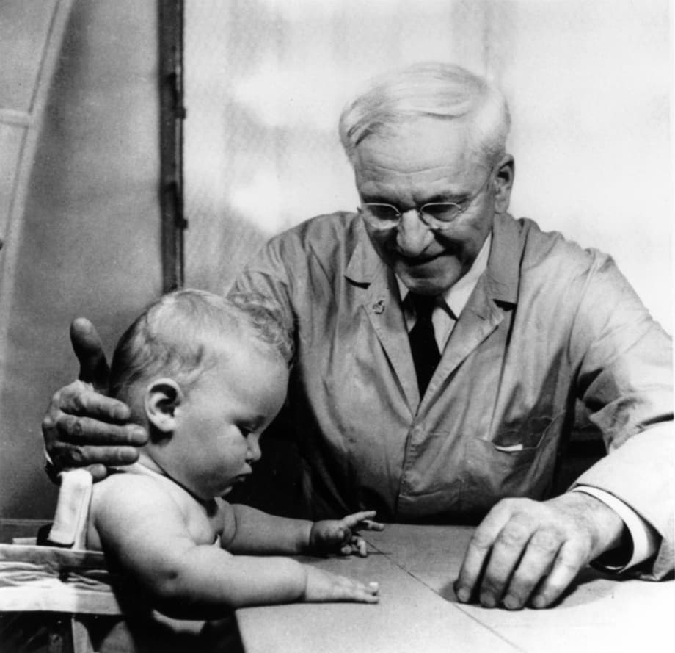
Types of Aptitude Tests (3 of 5)
Readiness Aptitude Tests
Arnold Gesell’s work on maturation.
Assessing readiness and mental well-being.
Notes:
Arnold Gesell’s work on maturation:
During the early 20th century, Arnold Gesell started the Child Study Center at Yale University.
Here, he documented the importance of maturation in the growth and development of young children.
He micro-studied maturation and created extensive film libraries of individual growth and development.
Assessing readiness and mental well-being:
Gesell was also interested in how ready children were for school.
While the term “aptitude test” was not coined until then, his tests assessed the readiness of children for school.
Readiness and well-being both fall under the broader umbrella of hygiene which is another term used for mental health then.

Slide 11
Types of Aptitude Tests (4 of 5)
Readiness Aptitude Tests
Purpose: Evaluate if a child is ready for school.
Readiness tests for different levels.
Notes:
Purpose of readiness tests:
According to Gesell, children become ready for a particular phase of learning and development at different times.
Introduction of readiness tests at all levels of education serve the purpose of evaluating whether a child is ready for school.
For instance, the Gesell Child Development Age Scale is designed to determine in which of the 10 Gesell early development periods a child is presently functioning.
The information is then used to determine if a child is ready for a particular level of activity.
Readiness tests for different levels:
The Graduate Record Exam (GRE) is used to determine whether students are ready for graduate school.
While the test is not called a readiness test, it is used to find out if the test taker is ready for what comes next.
That’s a prediction question, and that’s the business of aptitude tests.

Slide 12
Types of Aptitude Tests (5 of 5)
Clerical Aptitude Tests
Requirements for a clerical position.
The Minnesota Clerical Test (or MCT).
The outcome of MCT.
Notes:
Requirements for a clerical position:
A huge number of people who are employed in clerical positions such as file clerks to cashiers to administrative assistants.
These positions require great attention to detail, especially numbers and letters.
The Minnesota Clerical Test (or MCT):
One of the most famous and often used of these aptitude tests is the Minnesota Clerical Test (or MCT).
The test measures speed and accuracy in clerical work in high school students.
It contains 200 items, with each item containing a pair of names or numbers.
The test taker is expected to indicate whether the pair of names or numbers is the same or different.
The outcome of MCT:
The approach may seem overly simplified.
But the outcome where the final score is the number of incorrect responses subtracted from the number correct is accurate and highly predictive.

Slide 13
A Sampling of Aptitude Tests and What They Do (1 of 6)
SAT:
  Purpose and ages tested.
  Conceptual framework of the test.
  Interesting points about SAT.
Notes:
Purpose and ages tested:
SAT is one of the most often used aptitude tests.
Its purpose is to assess what is learnt in high school and how prepared a person is to succeed in college.
It measures reading comprehension, writing and math ability.
Used for freshman in high school and older students.
Conceptual framework of the test:
SAT websites states that there is focus on the knowledge, skills, and understandings that research has identified as most important for college and career readiness and success.
There is emphasis on the meaning of words in extended contexts and on how word choice shapes meaning, tone, and impact.
Interesting points about SAT:
The test includes an optional essay portion.
There is no penalty for guessing and therefore no extra deduction for a wrong answer.

Slide 14
A Sampling of Aptitude Tests and What They Do (2 of 6)
ACT:
  Purpose and ages tested.
  Conceptual framework of the test.
  Interesting points about ACT.
Notes:
Purpose and ages tested:
The test measures English, math, reading, and scientific reasoning.
It can be used for any age but mostly for people who are 13 and above.
Conceptual framework of the test:
The test is structured to measure general education development and ability to do college-level work.
Interesting points about ACT:
The test was developed as a competitor to SAT.
The test includes topic areas based on review of common state standards and surveys of educators as to what the important college skills are.

Slide 15
A Sampling of Aptitude Tests and What They Do (3 of 6)
Denver II:
  Purpose and ages tested.
  Conceptual framework of the test.
  Interesting points about Denver II.
Notes:
Purpose and ages tested:
This test is designed to screen for developmental delays.
The test scores four areas (personal-social, fine motor-adaptive, language, gross motor) and five test behavior ratings (typical, compliance, interest in surroundings, fearfulness, attention span).
It can be used in individual from birth till 6 years of age.
Conceptual framework of the test:
Children’s development tends to occur in a predictable pattern.
Although there are individual differences across ages, there are enough similarities that a general level of developmental competence can be assessed accurately.
Interesting points about Denver II:
The test was earlier called the Denver Developmental Screening Test.
It uses a visual form for recording scores that aligns with child’s chronological age and accounts for prematurity.
It is easy to use and quick and thus appeals to health care providers who are not necessarily trained in the administration of complex tests.

Slide 16
A Sampling of Aptitude Tests and What They Do (4 of 6)
Differential Aptitude Test (DAT) – Fifth Edition:
  Purpose and ages tested.
  Conceptual framework of the test.
  Interesting points about DAT.
Notes:
Purpose and ages tested:
The DAT measures students’ ability to learn or to succeed in many different areas.
It scores students in nine different areas: reasoning, numerical reasoning, abstract reasoning, perceptual speed and accuracy, mechanical reasoning, space relations, spelling, language usage, and total scholastic aptitude.
It can used for students in grades 7 to 9, grades 10–12, and adults.
Conceptual framework of the test: The test measures broad aptitudes that have relevance to different educational and occupational domains.
Interesting points about DAT:
It is mostly used in educational counselling and personnel assessment and often in career guidance.
It includes a practice test so students can become familiar with the type of items and time requirements.

Slide 17
What They Are: A Sampling of Aptitude Tests and What They Do (5 of 6)
Validity and Reliability
Validity: a unitary concept.
The need for criterion-based validity evidence.
Notes:
8.4. Compare and contrast several major aptitude tests.
Validity and Reliability
Validity: a unitary concept:
All types of validity arguments and evidence can come into play in determining validity of a measure.
But certain validity approaches seem particularly important for different tests with different purposes.
The need for criterion-based validity evidence:
Aptitude tests are meant to predict the future.
Therefore, the classic proof that they predict the future is a correlation between an aptitude test’s scores and scores on some relevant future measure, like college GPA or evaluations of professional performance.
So, it is criterion-based validity evidence (specifically predictive criterion validity) that is required, at a minimum, to convince people of an aptitude test’s validity.

Slide 18
What They Are: A Sampling of Aptitude Tests and What They Do (6 of 6)
Validity and Reliability
Demonstrating good test-retest reliability.
Correlations and reliability.
Notes:
Demonstrating good test-retest reliability:
In addition to the mandatory requirement of a high internal reliability estimate, for reliability, aptitude test developers might be particularly interested in demonstrating good test-retest reliability.
This is the evidence that the predictor (the aptitude test) is stable and doesn’t fluctuate easily depending on the wind or the day a person takes the test.
Correlations and reliability: Finding correlations between two sets of scores depends so much on the high reliability of both measures, and the stability across time of both scores is critical.

